Slide 1
Publishing in Major Journals & Getting Major Grants Consistently: A Personal Journey & Some Advice
Dr. Hsinchun Chen
Regents’ Professor, Thomas R. Brown Chair Professor
Director, AI Lab & AZSecure Cybersecurity Program
MIS Department, Eller College of Management
University of Arizona
April 1, 2023

Slide 2
Outline
My Disclaimers
My Background & Focus
Publishing in Major Journals Consistently (mostly design science in MISQ)
Getting Major Grants Consistently (mostly applied CS research in NSF)
Parting Thoughts

Slide 3
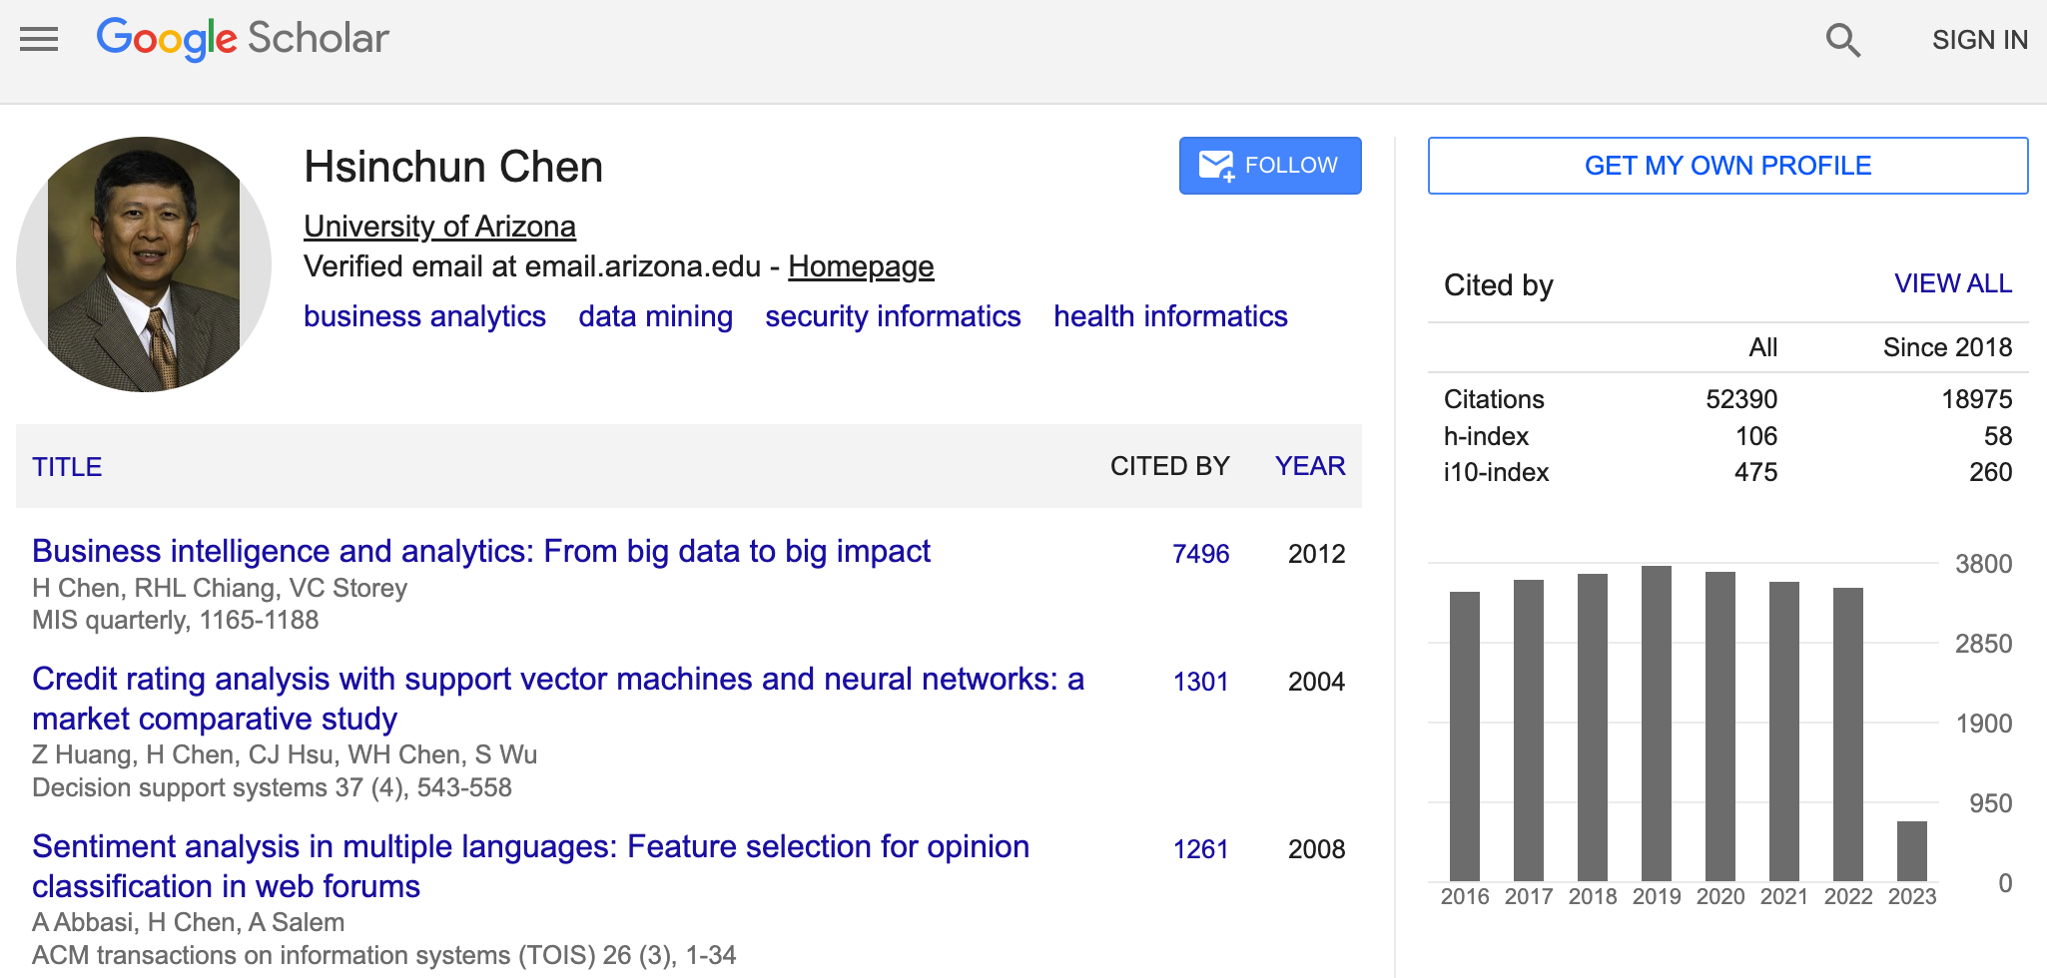
My Disclaimers:
Disclaimer 1: It’s based on my personal journey & experience (34 yrs).
Disclaimer 2: It’s about how to survive in b-school with consistent major journal publications (e.g., MISQ) in design science.
Disclaimer 3: It’s about how to consistently obtain major federal grants (e.g., NSF) to support high-impact applied computing research.
Disclaimer 4: Different researchers at a different time or place will have different opportunities.

Slide 4
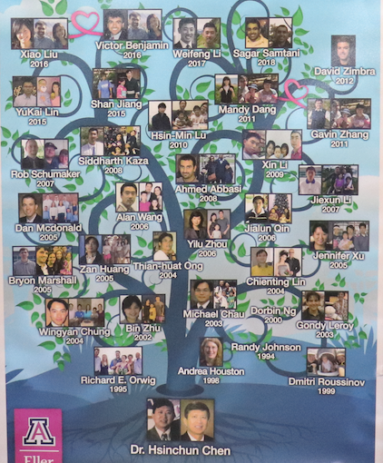
My Background & Focus: (1) Applied Computing & Design Science
Founded the UA Artificial Intelligence Lab in 1989 & UA AZSecure Cybersecurity Program in 2013 ➔ need a lab or program + Ph.D./MS students (36 PhD graduates, won 3 best dissertation awards in 25 yrs)
Internationally renowned for leading research and development in the health analytics (data and text mining; health big data; DiabeticLink and SilverLink) and security informatics (counter terrorism and cyber security analytics; security big data; COPLINK, Dark Web, Hacker Web, and AZSecure) communities. ➔ need focus and specialty in emerging fields

Slide 5

My Background & Focus: (2) Publications…
Author of 20+ books, 320+ SCI journal articles, and 220+ refereed conference articles covering digital library, data/text/web mining, business analytics, security informatics, and health informatic ➔ papers will come
Overall h-index 106 (52,000 citations for 900 papers according to Google Scholar), among the highest in MIS and top 50 in computer science ➔ citations will come
Editor-in-Chief, Senior Editor or AE of major ACM/IEEE (ACM TMIS, ACM TOIS, IEEE IS, IEEE SMC), MIS (MISQ, DSS) and Springer (JASIST) journals and conference/program chair of major ACM/IEEE/MIS conferences (ICIS, IEEE ISI, ICADL, ICSH) ➔ becoming a community leader

Slide 6

My Background & Focus: (3) Grants…
Received $60M+ research funding from NSF, NIH, NLM, DOD, DOJ, CIA, DHS, and other agencies (100+ grants, 50+ from NSF). Served as lead Program Director of the Smart and Connected Health (SCH) Program at the NSF for 2014-2015 ➔major funding helps, a lot!
A successful IT entrepreneur; His COPLINK/i2 system for security analytics was commercialized in 2000 and acquired by IBM as its leading government analytics product in 2011. ➔ some commercialization opportunities (founded 7 companies)
Visiting Chair Professor at several major universities in China (Tsinghua University) and Taiwan (National Taiwan University); Fellow of ACM, IEEE and AAAS ➔ kudos will come

Slide 7
Major Journals: i-School, c-School, b-School
i-School ($80K) & health informatics Journals: JASIST, ACM TOIS; JAMIA, JBI ➔ “informatics” (text) focused, system driven; helpful for NSF & NIH/NLM funding
c-School ($100K) Journals: ACM TOIS, IEEE TKDE, CACM, IEEE IS, IEEE Computer, IEEE SMC ➔ algorithm/computing focused, data driven; helped significantly with NSF funding (same for major CS conferences)
b-School ($200K) Journals: MISQ, ISR, JMIS, MS, ACM TMIS, DSS ➔ “design science” focused, managerial framework/principle/knowledge base; helped get jobs in major b-schools (little federal funding)

Slide 8
Major Journals: The Process & Learning Curve
Training in BS, MS, Ph.D. ➔ needing strong methodological (e.g., DL, NLP) and domain (e.g., cybersecurity, health) training; needing matching, helpful advisors/mentors (becoming your own)
Becoming a researcher & author ➔ completing “novel” research (methodology or domain); writing from conference paper to journal paper; learning from your advisors/mentors
Becoming a reviewer & AE ➔ becoming a PC member; doing professional reviews; impressing senior AE/SE/EIC; publishing in target journals; networking in major conferences
Becoming SE/EIC ➔ Becoming a community leader; It takes time.

Slide 9
Major Journals: My Journey
Training in BS, MS, Ph.D. ➔ NCTU, U Buffalo, NYU; AI, DB, IR; Ph.D., 1985-1989
Becoming a researcher & author ➔ AAAI, IJMMS, IEEE SMC, JASIST, CACM, ACM TOIS; DSS, JMIS; assistant prof, 1989-1996
Becoming a reviewer & AE ➔ IEEE SMC, JASIST, ACM TOIS, DSS; associate/full prof, 1996-1998+
Becoming SE/EIC ➔ IEEE IS, ACM TMIS, MISQ; full/chair prof, 2008+
Helping to select next EIC ➔ ISR EIC search

Slide 10
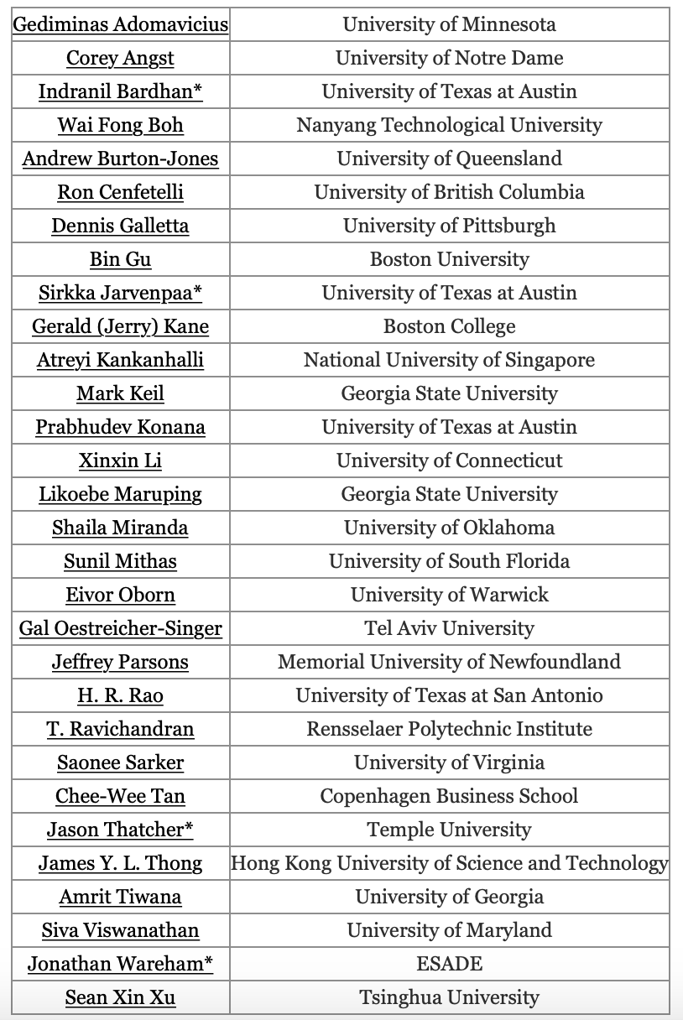
Major Journals: MISQ & JMIS
MISQ SEs
MISQ: A+ journal, #1 in MIS
behavior/management focused traditionally (most SEs)
recent focus in business analytics & data sciences (SEs: HRR, GA, IB, PK, JP) ➔ selecting the right SEs/AEs
Computational design science: application-inspired novelty (algorithm, representation, framework, HCI) + societal impact ➔ significant content & mature writing (40+ pages)
MIS-specific lit review + methodology/framework/design “theory” + contribution to KB + principles (research abstraction) ➔ right packaging
JMIS: A journal, #3 in MIS
Same as above; more system driven
Zwass + Nunamaker; HICSS special issue

Slide 11
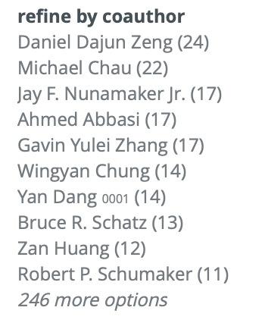
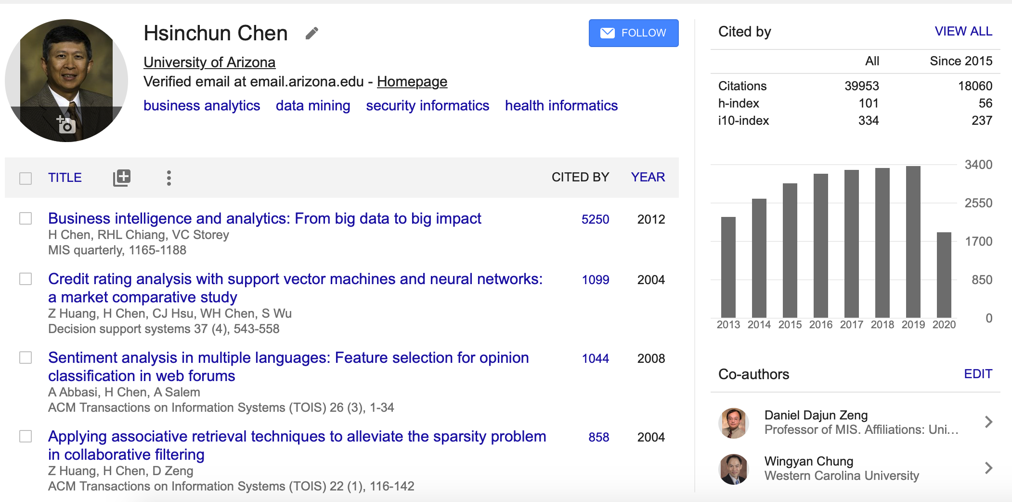
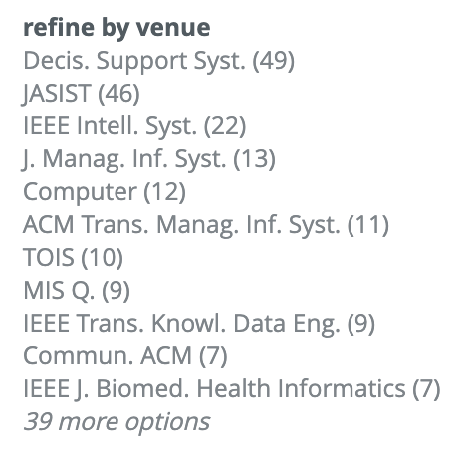
Major Journals: Chen, i-, c-, b-school, CISE
Work hard; be persistent; colleagues & students help a lot; a little bit of luck helps

Slide 12
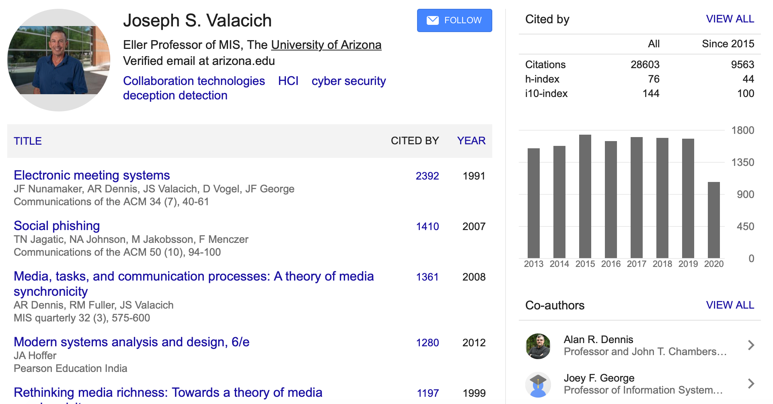
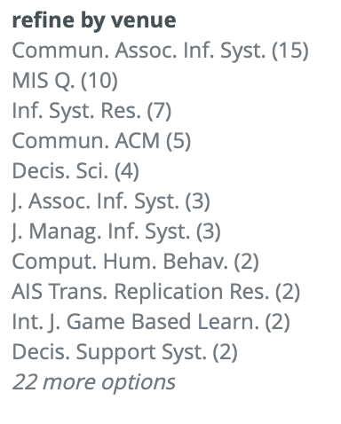
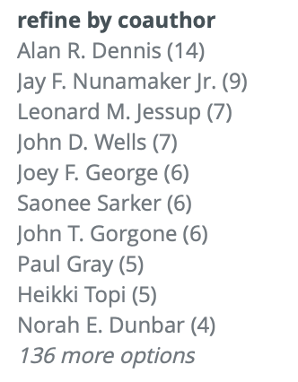
Major Journals: MISQ, Dr. Joe Valacich
HCI, CSCW, SBE

Slide 13
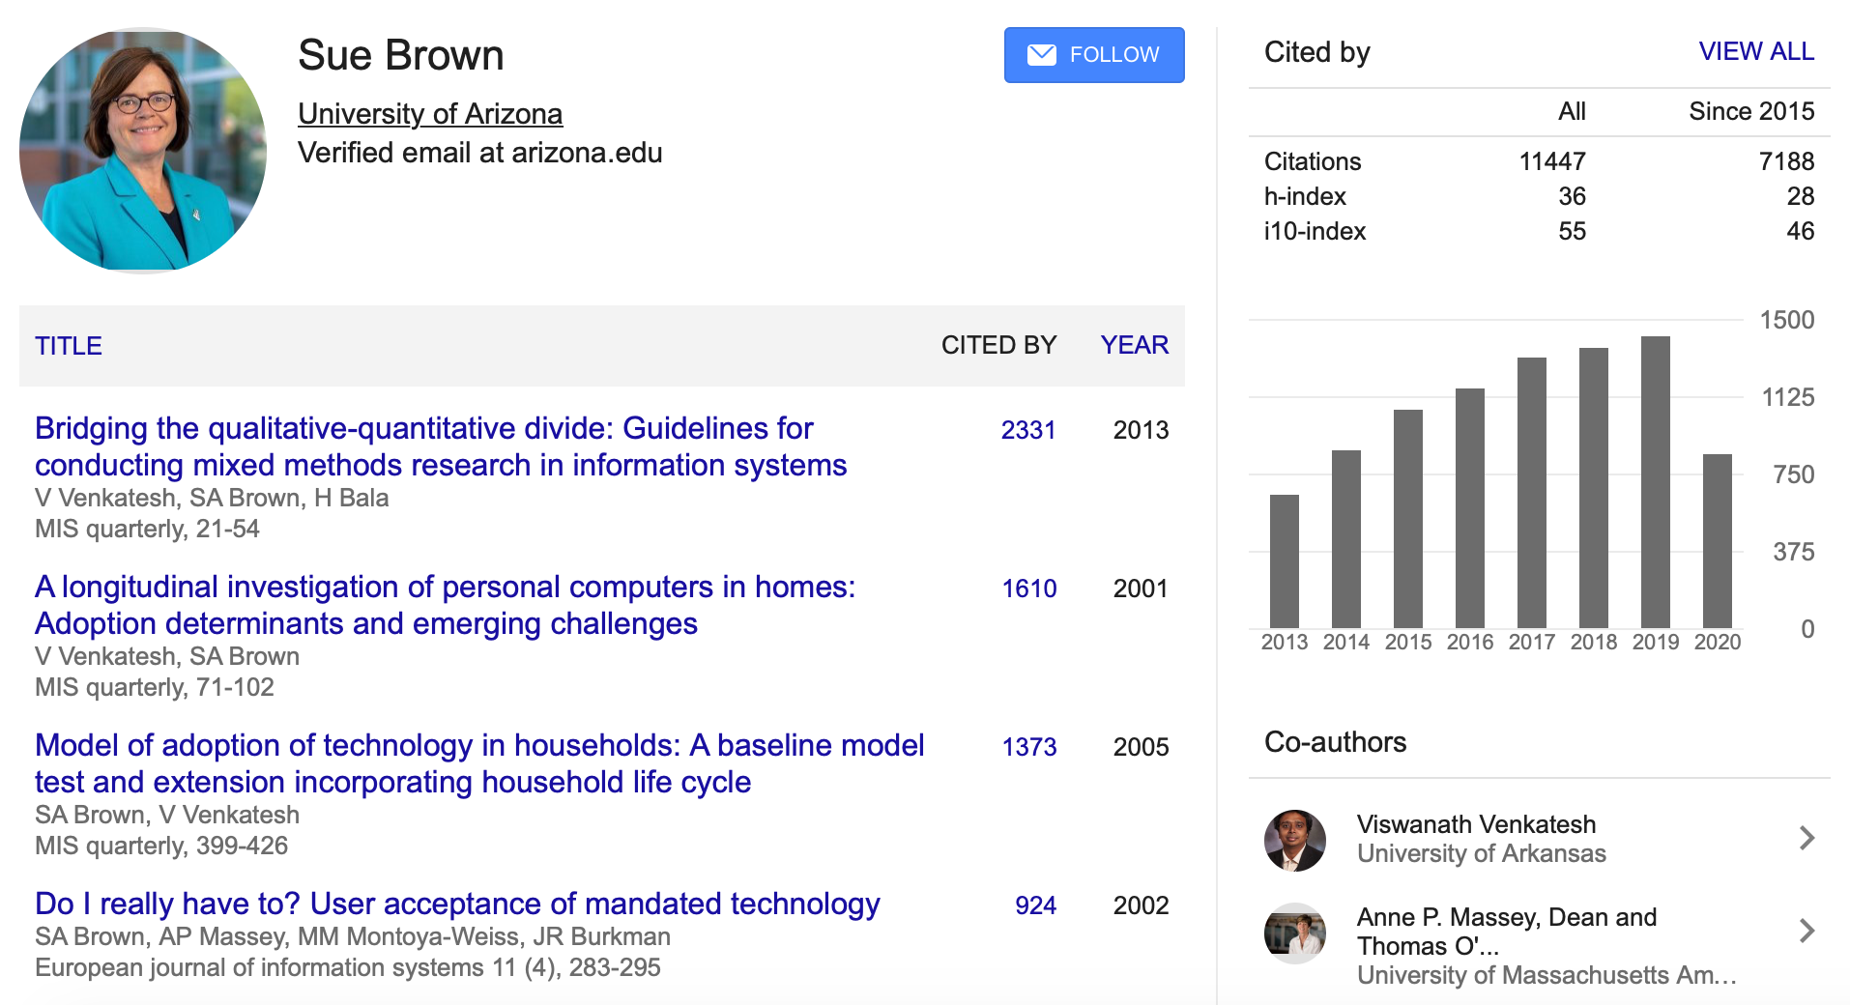
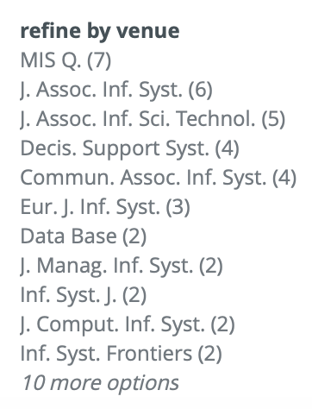
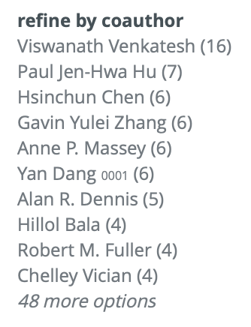
Major Journals: MISQ, Dr. Sue Brown
IT Adoption, SBE

Slide 14
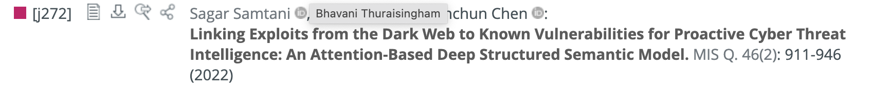

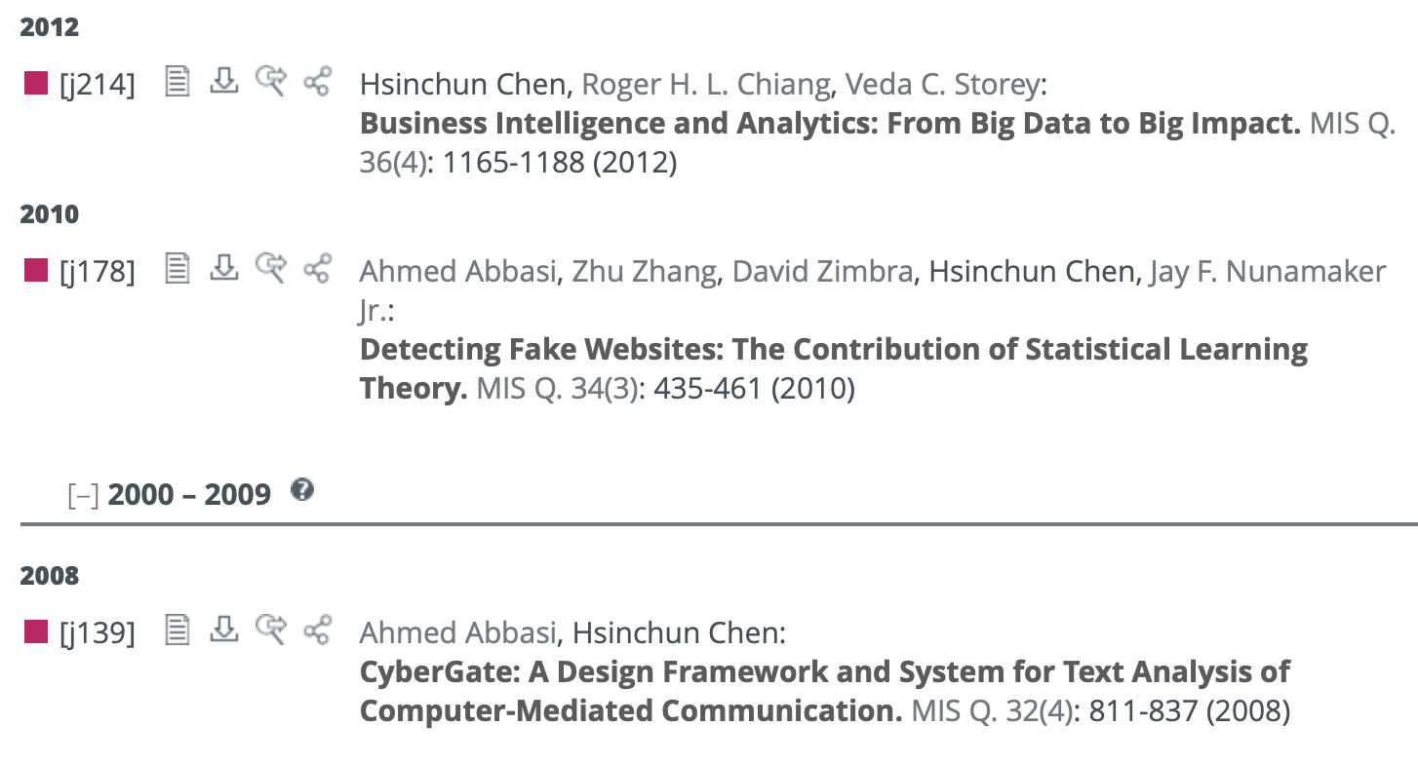

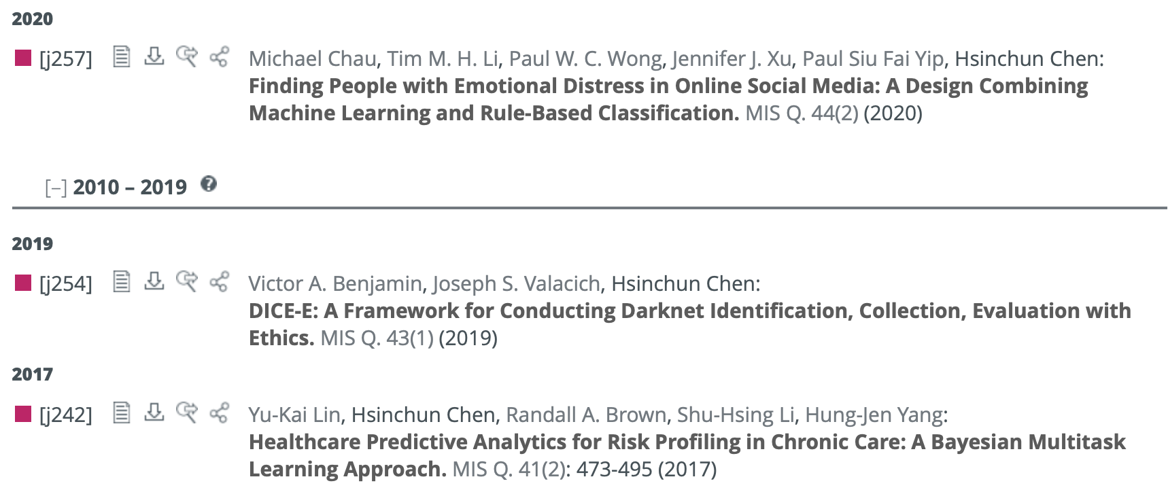
Major Journals: Chen, AI Lab Computational Design Science (CDS) Papers in MISQ, 2008+
2021-2022
Special Issue, Business Analytics; 7496 citations
Health/Security Analytics; Deep Learning
Health Analytics
Security Analytics; Best Paper, ICIS, 2010
Security Analytics
Social Media Analytics
Health Analytics

Slide 15
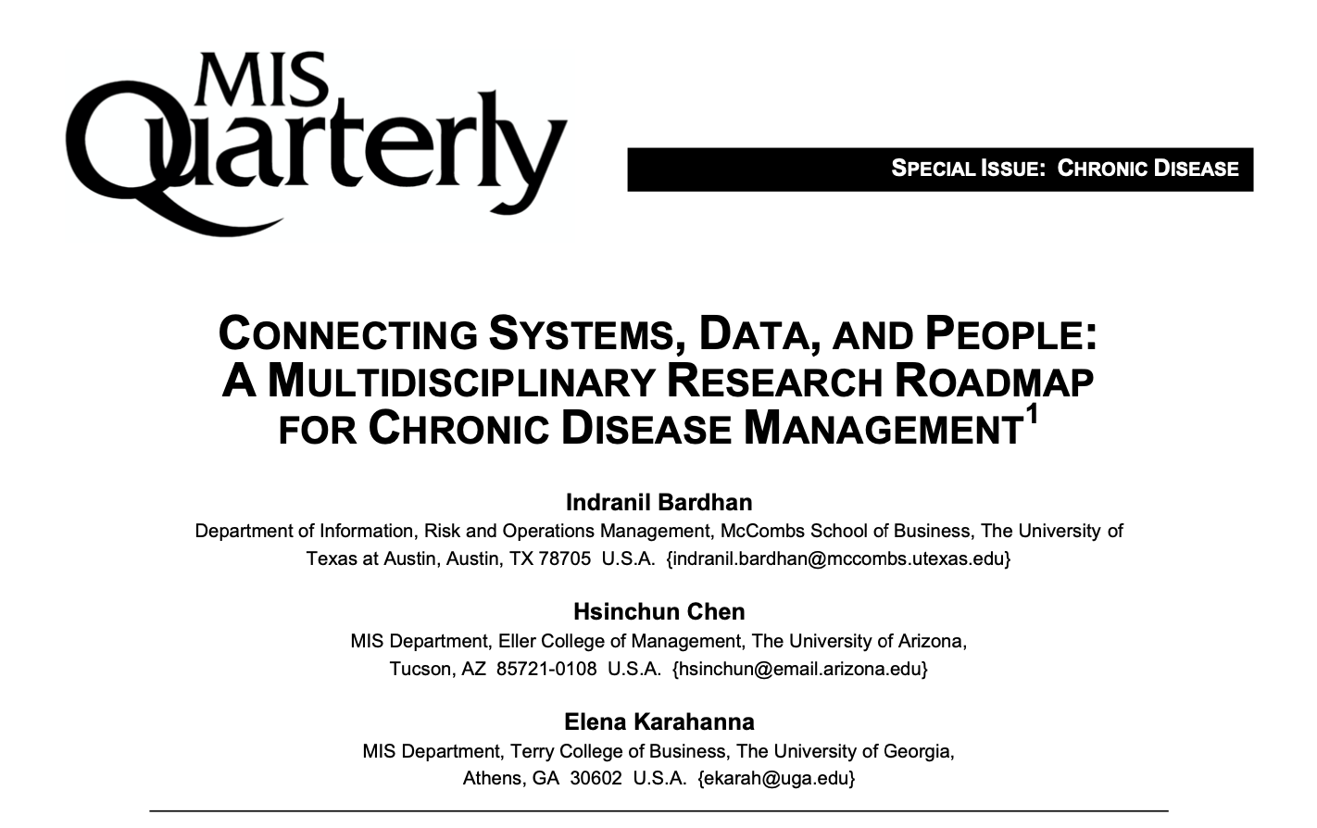
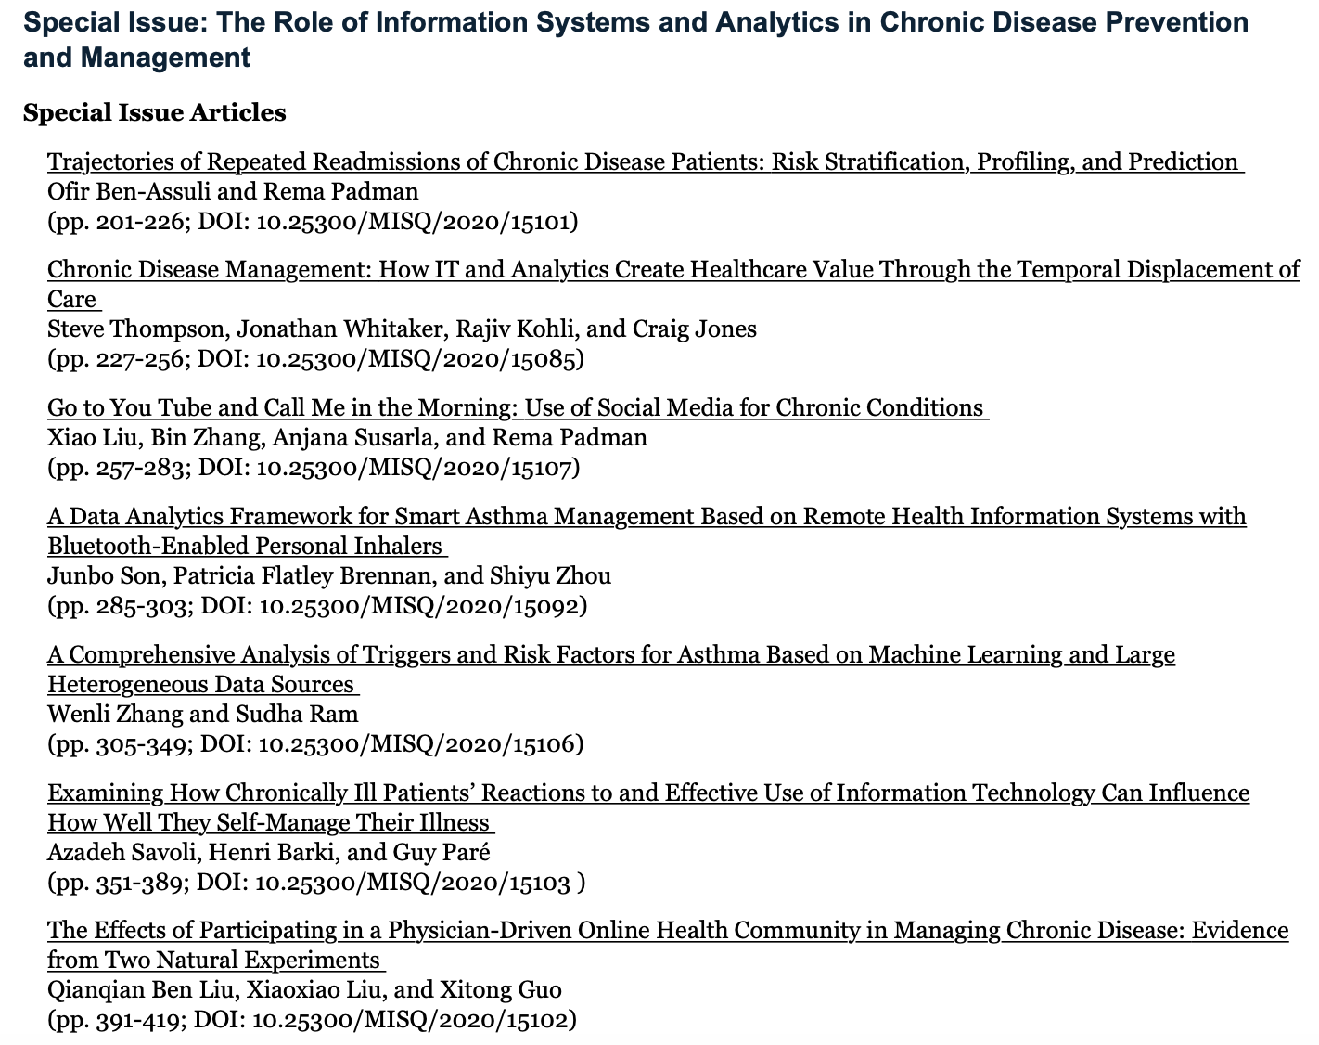

Major Journals: Health IT & Analytics Special Issue, March 2020

Slide 16
Major Journals: MISQ CDS Common Issues
MISQ, My Experience: no paper/involvement before 2008 (no SE in design science); Abbasi 2008 (CyberGate), 2010 (AZProtect, ICIS best paper); Guest Editor, BI&A special issue, 2010-2012 (Straub); SE 2016-2019 (Rai); Guest Editor, Health IT/Analytics special issue, 2016-2020 (Rai)
Design Science paper common issues:
Where is the theory? Is this MIS? (early reviewers’ critiques)
Few qualified/sympathetic design science SEs, AEs, reviewers. (overly critical)
Long review cycle (2-4 rounds/years) and uncertainty (rejection at late round).
➔ but
BI&A and data sciences are hot, in society and in b-school curriculum!
Young MIS CDS scholars need 1-2 MISQ/JMIS papers accepted or in deep round.
Mid-career MIS CDS scholars need 3-5 MISQ/JMIS papers for tenure.

Slide 17
Major Journals: MISQ CDS Paper Template
Computational design science (Chen in Rai, 2017): application-inspired novelty (algorithm, representation, framework, HCI) + emerging high-impact problems
Significant content & mature writing (40+ pages)
MIS-specific lit review (3-4 pages) ➔ Who/what had (been) published in MISQ/ISR/JMIS (10-20 MIS references, taxonomy, analytics relevance)
Methodology/framework/design “theory” (2-3 pages) ➔ underlying methodological foundation (not behavioral theory of +/- hypotheses), e.g., Systematic Functional Linguistic Theory, Kernel Learning Theory, etc.
Contribution to KB + principles (research abstraction; 2-3 pages) ➔ What have been learned about the design, use and general knowledge gained?
➔ Carefully study sample MISQ DS papers, e.g., (Abbasi, 2008; 2010).

Slide 18
Major Journals: MISQ CDS Review Process
Make sure the research fits. ➔ Emerging high-impact problems + some (not a lot) application-inspired novelty
Make sure writing is mature. ➔ Error-free! (40+ pages)
Select the “right” SEs and AEs. ➔ Recruit and/or consult a senior experienced MISQ DS scholar.
1st-round review; hope for the best after 6 months. ➔ Getting Major Revision is good (10+ pages of feedback is common)! Now their demands are clear!
1st-round revision is important; in 6 months. ➔ Showing appreciation, respect and tangible revision actions. Don’t fight/argue! (50+ pages of response letter!)
2nd/3rd/4th round review/revision ➔ Removing one critical reviewer at a time; more Minor Revision and/or Accept over time
Final decision; 2-4 years later ➔ Eventually the SE needs to make a decision. Everyone is tired after so many years!

Slide 19
Major Grants: NIH, DARPA, DHS, IARPA
NIH: NLM is informatics-focused; “translational” research with some application-inspired health-related novelty; need pubs and networking in AMIA/JAMIA; strong health informatics (NLM) tradition and turf (strong personality) ➔ Chen as NLM Scientific Counselor, 2002-2006
DOD/DARPA: was innovative, basic/foundational, long-term (ARPA Net); now mission-critical, system-driven, short-term; commercial company (defense contractor) as prim, academic as sub; bi-monthly milestones/metrics/reporting ➔ Chen early success with DARPA/IARPA/DHS for COPLINK/Dark Web research
DHS, IARPA: similar to DARPA, but aspiring; lesser scientific quality (strong personality)
➔ Not my focus any more! (Need to smell like them.)
Notes:
but less quality

Slide 20
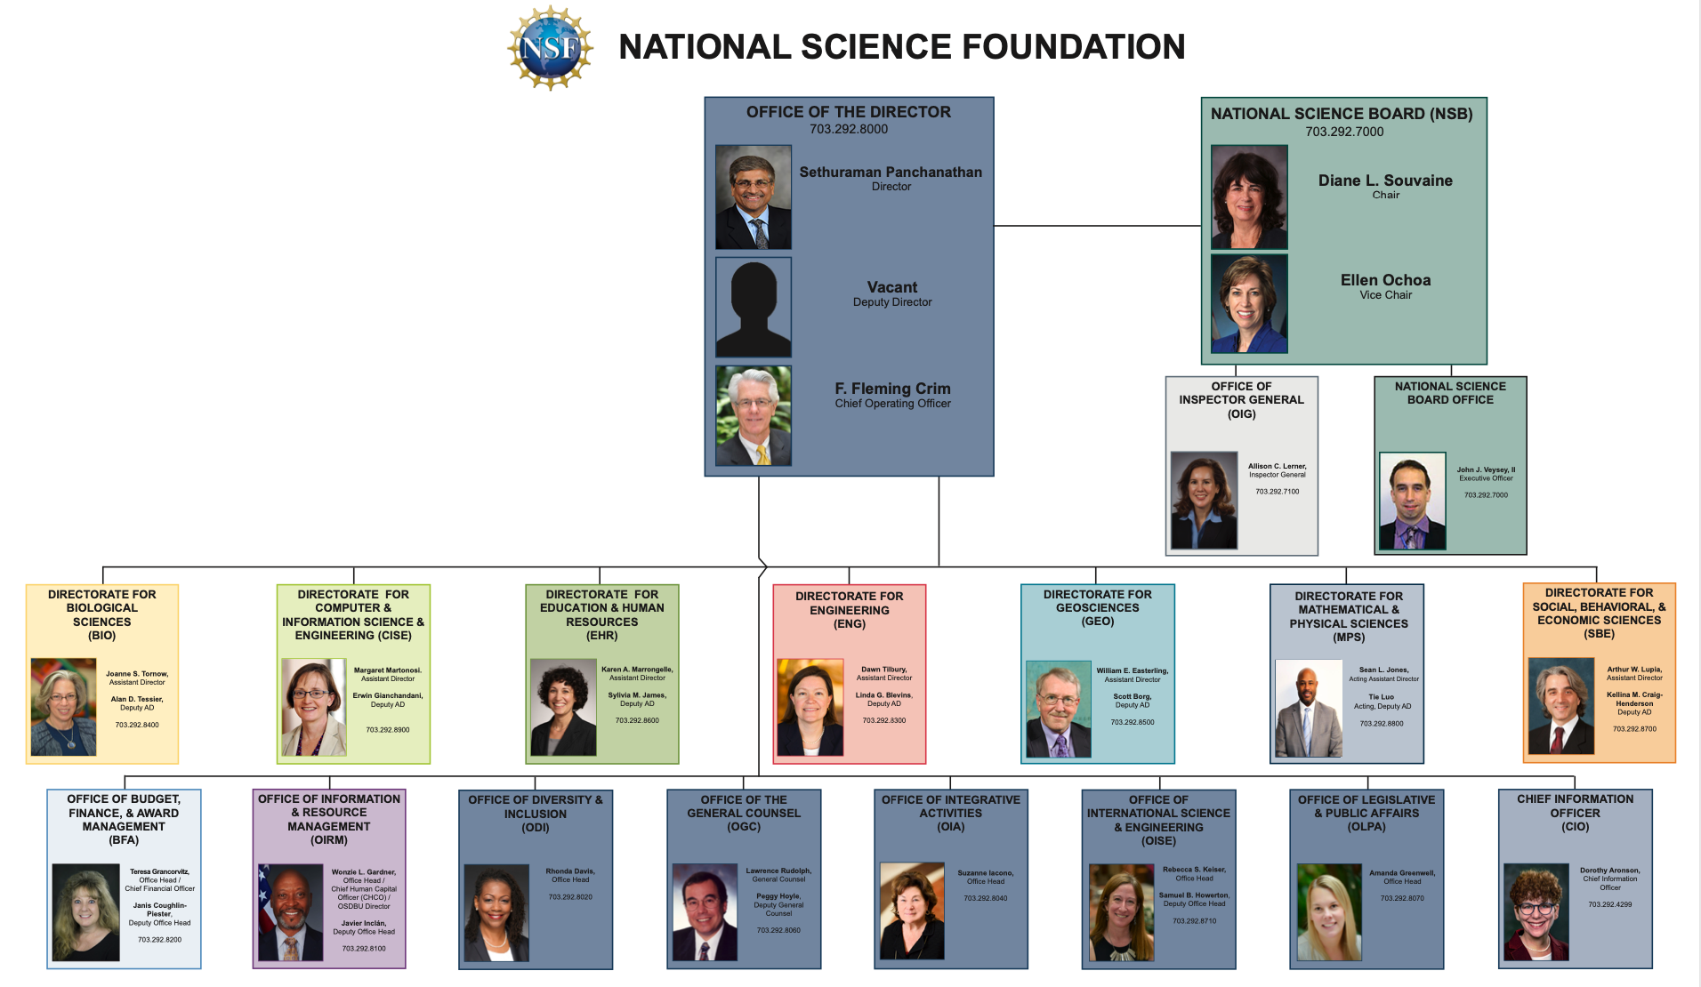
Major Grants: NSF Org Chart
($8.3B)
BIO
CISE
EHR
ENG
GEO
MPS
SBE

Slide 21
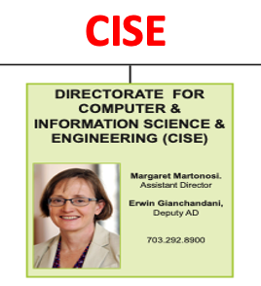
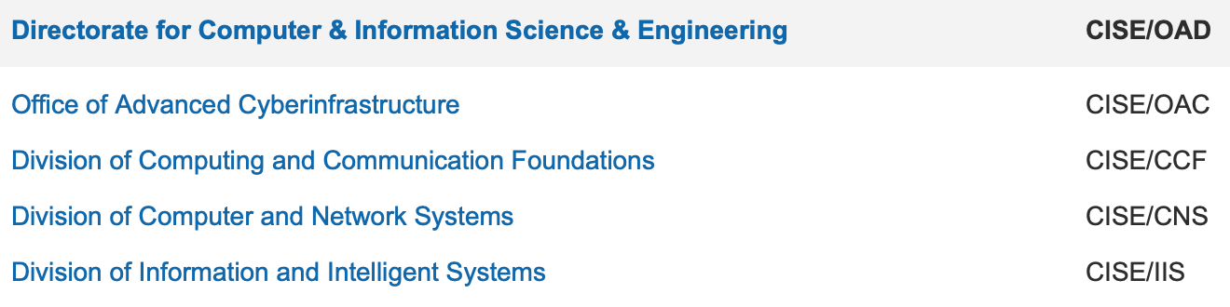
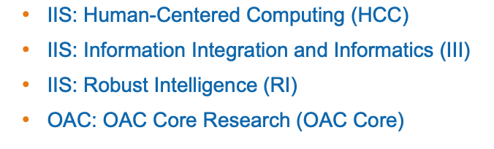
Major Grants: NSF CISE/IIS/III
IIS/OAC
III

Slide 22
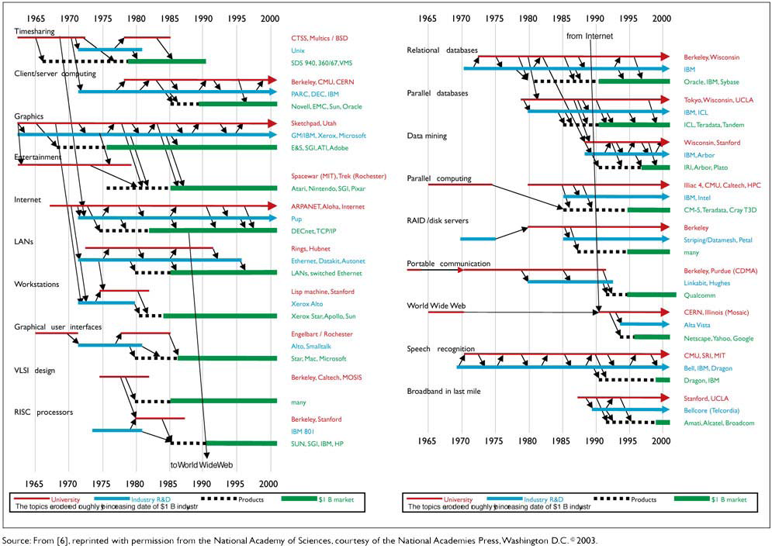
Major Grants: NSF CISE IT Impacts
University research ➔ Industry R&D ➔ Products ➔ $1B Market (job and wealth creation)

Slide 23
Major Grants: NSF Programs
CORE: NSF CISE/IIS/III CORE most relevant to fundamental research in AI, machine learning, WWW, data sciences, NLP; acceptance rate 6-8%, highly competitive, critical young CS reviewers ➔ IIS Core ($100M/yr)
OAC: NSF CISE/OAC relevant to applied cyberinfrastructure for sciences; acceptance rate 20-30%, less competitive, reviewers including CS, SBE, and domain sciences ➔ DIBBs, CICI ($25M-30M/yr; my focus)
Applied Programs: Many emerging cross-directorate (e.g., EHR, SBE, CISE) and cross-agency (e.g., NSF, NIH, DOD) high-impact applied research programs (e.g., security, health); acceptance rate 15-20%, less competitive, reviewers including CS, SBE, and SME ➔ SaTC, SFS, CCRI, SCH, BIGDATA, I-DSN, National AI Institutes ($50M-100M/yr; my focus)
Young Scholars: Many opportunities for early-career scholars; acceptance rate 10-20%, competitive, for early career; valuable for obtaining tenure! ➔ CRII, CAREER + EAGER ($200K-$1M for each award)
Notes:
but less quality

Slide 24
Major Grants: NSF Proposal Observations
Computational Design Science (CDS) has excellent chance for successful proposals (CISE). ➔ in general, not so much for behavioral or economics MIS researchers (SBE; too basic, too incremental, not novel).
“Business” (finance, accounting, marketing) school research is not considered STEM. ➔ need to position for larger societal/STEM problems.
CDS research needs to compete with CS researchers (“locusts” in emerging technical fields); deep & novel domain application for emerging societal problems could be viable. ➔ my approach at least, for the past 30 years: digital library, intelligence, health, cybersecurity, etc.
Need application or domain-inspired novelty for applied cross-directorate programs. ➔ senior Ph.D. students; last 1-2 dissertation chapters
A lab or center can help with sustainable advantage and funding. ➔ developing collection, prototype system, etc.; structure & organizational memory
Notes:
but less quality

Slide 25
Major Grants: NSF The Process
NSF Funding Criteria: “transformational” research; Intellectual Merit (IM, 60-80%) + Broader Impacts (BI, 20%-40%); depending on Core or Applied Program
The Process:
Select the right program and project size.
Consult experienced senior scholars.
Select emerging novel research under way (your strength; 50% done, unpublished) for a proposal.
Develop the proposal (15 pages) and supporting documents (20-40 pages) in 1-2 weeks.
Submit and be prepared to get rejected!
Learn from the written panel reviews. Contact the Program Director (PD) to seek feedback.
Repeat 1-6 for 2-3 times for the same program. Volunteer to the PD to be a panelist.
Learn from reviewing other proposals and actual panel reviews & decisions at NSF. (2 days, 8 panelists, each do 8/22 proposals)
Repeat 1-8 2-3 times until receiving grant or giving up (in 3-4 years)!
Notes:
but less quality

Slide 26
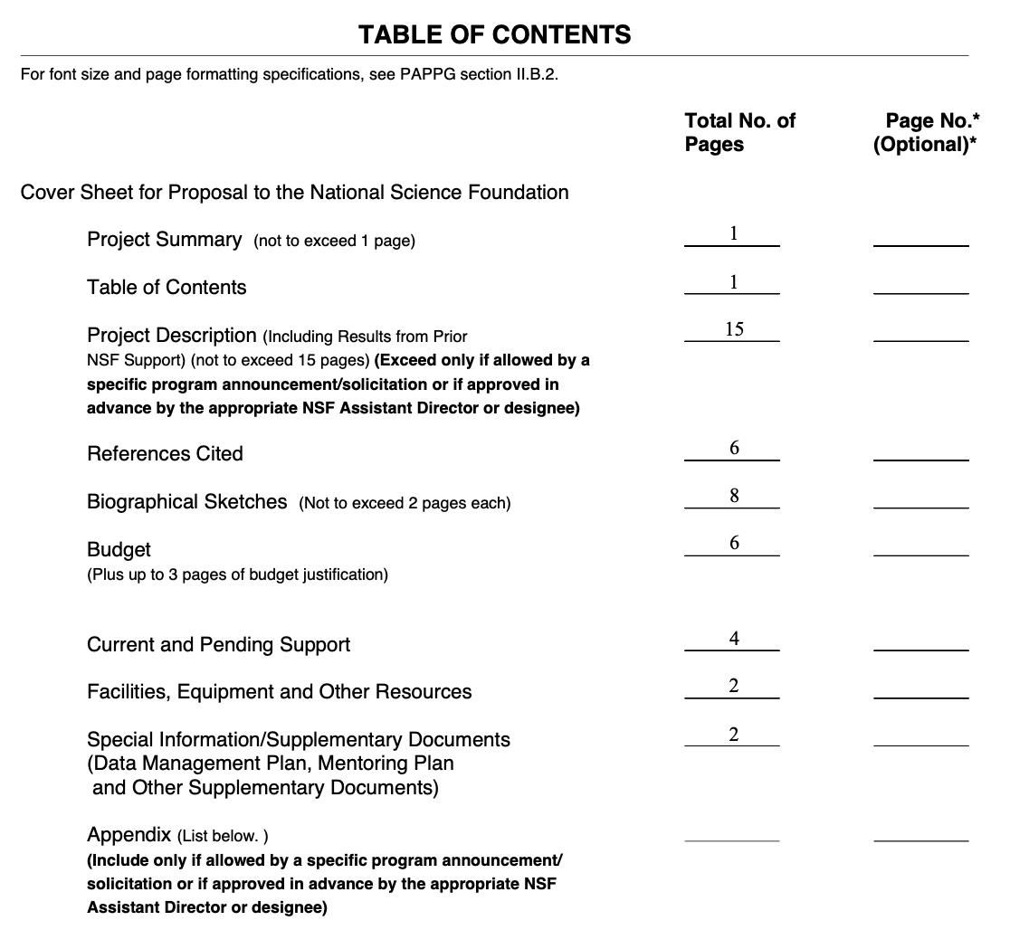
Major Grants: NSF Proposal Template
Proposal title: short and succinct; need a multi-disciplinary team
Project summary: Summarize problems and approach; include IM + BI
Main text (15 pages)
Need mature writing; good diagrams
Need methodological/algorithmic novelty (IM, 60%); need strong impacts (BI, 40%)
Need good lit review (state-of-the-art) & promising preliminary results
CV: need relevant ACM/IEEE references; MISQ/ISR pubs help very little
Others: Good to have office support, e.g., budget, facilities, DMP, routing, etc.
Notes:
but less quality

Slide 27
Major Grants: NSF Proposal Reviews
As a reviewer/panelist:
Asked to review 7-8 proposals (out of 20-22) in 2-3 weeks
One-page review, overall rating: E, VG, G, F, P (few with E or VG)
Only 2-3 proposals received Competitive or Highly Competitive (fundable; 90% proposal) in each panel (2/20)
On-site panel discussion critical for outcome (vocal panelist)
As a proposer/PI:
Will receive 4-5 reviews, varying from VG, G, F (aiming 80%; rarely receiving E).
Common IM critiques: lack of novelty, poor lit review, missing preliminary results
Common BI critiques: value unclear, lack of diversity/education plan
Other significant critiques: lack of track record, poor team, lack of collaboration plan, etc.
Need to improve from 10% success rate (60% proposal) to 30% (80% proposal) over time in 2-3 tries.
Learn the process and grantsmanship for future proposals.
Notes:
but less quality

Slide 28
Major Grants: NSF General Advice for CDS Scholars
Develop methodological novelty and application-specific strengths over your career. ➔ world-class excellence vs. other CS scholars
Train your Ph.D. students well. ➔ their last 2 dissertation chapters could be fundable; they can be trained to write proposals (scale & efficiency)
Build a center/lab/group. ➔ more sustainable and impressive (common in CS, ECE, MED)
Improve your grantsmanship. ➔ get to know your PDs and become frequent NSF panelists (getting into their heads)
Improve your success rate to 30% (one in 3). ➔ target repeating programs for re-submissions
Monitor and anticipate current and emerging programs. ➔ prepare the next proposals; repeat the cycle!
Notes:
but less quality

Slide 29
Parting Thoughts: Hard Work + A Bit of Luck
Societal Impact > Academic Impact
Looking for high-impact societal problems (NYT, WSJ, The Economists)
IT > MIS
MIS is a smaller subfield within broader IT/computing.
CISE > SBE
Computational Design Science can make a difference.
New > Old
Looking for new, interesting, unknown problems
EQ > IQ
Hard work, discipline, aspiration, etc. always beat raw talent. Plus a bit of luck!
Notes:
but less quality

